Slide 1
Violence in the Workplace Negotiating Collective Agreement Language Version 3 – Winter 2020
Tom McKenna
CUPE National Health and Safety Representative
Nothing in this presentation supersedes the Legislation, Regulations and Policy. There may also be Collective Agreement rights and obligations. This information is not legal, treatment or counselling advice. This information is for CUPE use only, cannot be used in any other proceeding and is without prejudice and precedent to any labour relations matter, bargaining, grievance, or arbitration. Each case is subject to the fact pattern and to the changing jurisprudence. Always adhere to Human Rights and to Privacy legislation.

Slide 2
Table of Contents
Introduction
Violence Statistics
Where Violence Occurs
How is Violence Defined?
Legislation, Occupational Health & Safety Regulations, Policy and Guidelines
Preparing for Bargaining
Areas in the Collective Agreement to Address
Specific Collective Agreement Articles to Address
Problems and Barriers to Bargaining Collective Agreement Language
Resources and Links
Questions
This Power Point is accompanied by a separate pdf document (see next Slide) which contains more information. Please read both documents.

Slide 4
Always use these materials in conjunction with
CUPE National resources,
the Collective Agreement,
CSA Group Standards,
Canadian Centre for Occupational Health and Safety resources and
WorkSafeBC materials

Slide 7
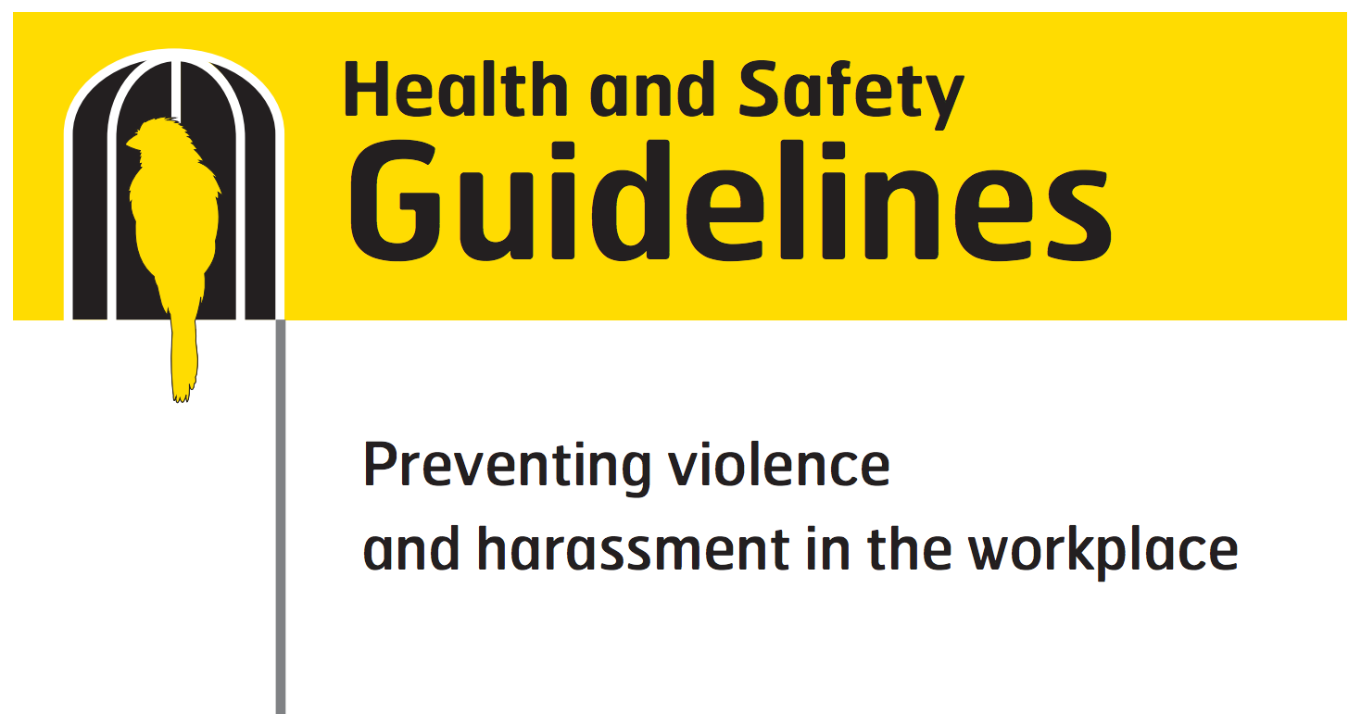
This presentation incorporates some humour – however – violence should always be taken seriously.
Nothing in this presentation should detract from that.

Slide 8
Introduction
While this presentation uses the term “employees,” “workers” (which often refers to contract workers, interns, and in some cases volunteers) is used by WorkSafeBC.
Changes to the Occupational Health and Safety Regulations, Policies and Guidelines may occur in the next year. See the BC Federation of Labour submission on amending the violence OHS Regulations.
The Joint Health and Safety Committee has a very important role, yet as per WorkSafeBC, up to 90% of these committees are not properly functioning.

Slide 9
Introduction cont’d.
It is the primary responsibility of the Employer to provide a safe workplace by removing or controlling hazards and risks
Strong Collective Agreement language improves the safety of employees and accountability of Employers.
Many CUPE Locals have negotiated Collective Agreement language regarding violence. Also see the Hospital Employees’ Union and the B.C. Government and Service Employees’ Union Collective Agreements.

Slide 10
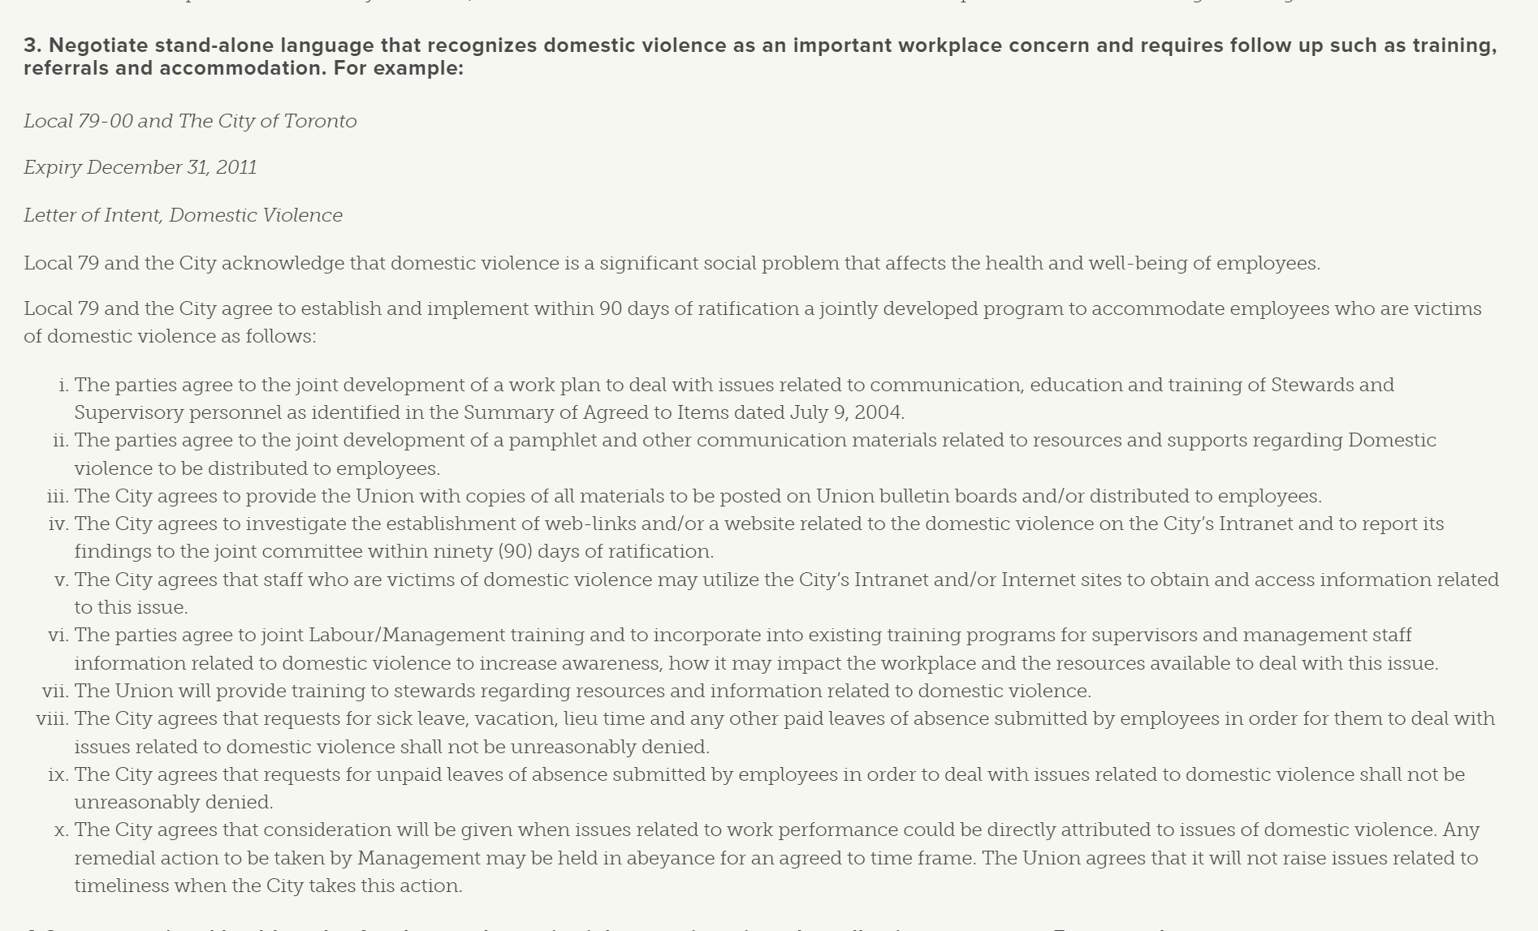

Slide 11
Introduction cont’d.
Always check the WorkSafeBC website for the most current Legislation, Regulations, Policies, Guidelines and Practice Directives. They change often.
Ensure that your CUPE National Representative is updated and involved at all levels of Occupational Health and Safety, Labour Relations and Collective Bargaining.
If there are overlapping Collective Agreement, Human Rights, WorkSafeBC, Disability Plan and other requirements, how will these be coordinated?

Slide 13
Introduction cont’d.
Remember:
It is often within the exclusive and / or concurrent jurisdiction of WorkSafeBC to address Claims and Prevention issues. There have been at least 3 key arbitration decisions. Be careful of this when filing grievances and determining who has jurisdiction. Always speak with your CUPE National Representative.

Slide 14
Violence Statistics
Violence is increasing across Canada, especially in K-12.
WorkSafeBC statistics show that only a small number of serious injury claims result from violence – however, this does not reflect non-serious injury claims, bullying and harassment, claims that were not filed / unreported claims, etc. Under-reporting is rampant – especially by workers in precarious employment and in K-12 in general.
Healthcare, Education / K-12, and Social Services all having much higher levels of violence.

Slide 15
Violence Statistics cont’d.

Slide 16
Violence Statistics cont’d.
The overall injury rate, all causes, has been increasing in Education, as per the most recent WorkSafeBC data:

Slide 17
Violence Statistics cont’d.
Health care workers suffer a greater number of time-loss injuries due to violence than any other occupation.
Healthcare and Social Services account for the majority of the time-loss claims as per WorkSafeBC for all types of injuries – not just violence.
In the past 10 years there has been a 70% increase in violence-related claims in the Health Care Sector.

Slide 18
Violence includes harassment and bullying. These are often precursors to physical violence

Slide 19
Violence Statistics cont’d.
In Ontario, 61% of Social Service and Institutional employees were verbally threatened.
42% of employees in Social Services were physically threatened
30% of employees in Social Services were physically assaulted.
Women and workers in precarious employment are at higher risk and the risk is growing every year.

Slide 20
Violence Statistics cont’d.
In Montreal, 87.5% of Inside Municipal employees reported psychological violence
67% had been threatened 3 or more times
23% had been physically assaulted
12% had been sexually assaulted
Nationally, 19% of violent incidents involved a weapon
66% of violent incidents were committed by someone known to the employee

Slide 22
Where Violence Occurs
Violence comes from many sources e.g. members of the public, managers, supervisors, co-workers, board members, students, patients, parents, clients or passengers.
Employees who are most affected include new workers, young workers, working alone or in isolation, Healthcare, Education and Social Services.
Employers must ensure new and young workers have received an orientation by the Union. See the resources on the CUPE BC OHS Committee website.
Notes:
re: bullet #1 – there has never been a prosecution under Section 13
re: bullet #3 – ask participants if they have any examples of this
Instructor examples – “If you don’t claim, I’ll just pay you.” Some companies will send employees to Hawaii if there are zero reports made to WCB. This is commonly referred to as an inducement program.

Slide 23
How is Violence Defined
The definition of violence should be as expansive as possible. The definition is always changing and may need to be updated annually.
The Workers Compensation Act and Occupational Health and Safety Regulations, including the Guidelines, should only be the starting point.
BC has some of the least protective language for workers regarding violence in Canada.

Slide 24
How is Violence Defined cont’d.
CUPE National defines violence as:
“Violence in the workplace is any incident(s) in which an employee is threatened, assaulted or abused during the course of their employment that may cause physical or psychological harm. This includes threats, attempted or actual assault, application of force, verbal abuse or harassment. Harassment is offensive behaviour that a reasonable person would consider unwelcome. The workplace is any location in which work-related activities under the control of the organization are performed.”
This definition is subject to frequent change, as are the Legislation, Regulations, Policies and Guidelines.

Slide 25
In one study in the Education Sector
1/3rd of all forms of violence (such as bullying and harassment) involved management / excluded employees
Performance evaluation time!

Slide 26
How is Violence Defined cont’d.
Violence occurs on a continuum and includes verbal violence, bullying and harassment, among many others.
Violence often escalates from one form to another, and not necessarily in any particular order or sequence.
Include categories and broad definitions of violence such as:
(See next slide for a partial list. The accompanying document identified on Slide 3 of this Power Point provides a much more detailed list)

Slide 27
How is Violence Defined cont’d.
Verbal abuse
Verbal threats
Threatening behaviours
Written abuse
Written threats
Harassment and bullying
Stalking
Sexual harassment
Physical assaults
Domestic violence

Slide 29
Legislation, Occupational Health & Safety Regulations, Policy and Guidelines
Key areas of the current OHS Regulations include:
Occupational Health and Safety Regulation (“OHSR”) 4.27 - 4.31 - Violence in the Workplace
“"violence" means the attempted or actual exercise by a person, other than a worker, of any physical force so as to cause injury to a worker and includes any threatening statement or behaviour, which gives a worker reasonable cause to believe that he or she is at risk of injury.”

Slide 30
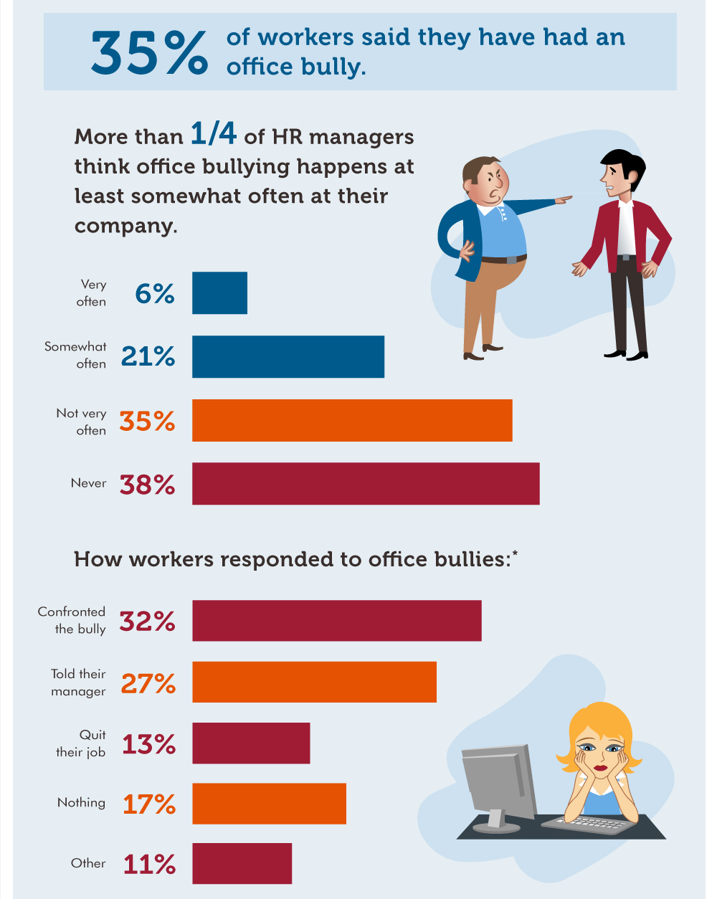
Studies show that bullying occurs in over 40% of workplaces with over 2/3rds of employees witnessing bullying and harassment

Slide 31
Legislation, Occupational Health & Safety Regulations, Policy and Guidelines cont’d.
Other applicable Sections include (red underlined sections are key):
3.9 – Remedy Without Delay
3.10 – Reporting Unsafe Conditions
3.11 – Emergency Circumstances
3.12 – Refusal of Unsafe Work
3.13 – No Discriminatory Action
3.22 to 3.25 for Young Workers e.g. 3.23(2)(e)(f)

Slide 32
Legislation, Occupational Health & Safety Regulations, Policy and Guidelines cont’d.
3.28 - Participation by Employer or Representative of Employer and Worker Representative
4.13 – Risk Assessment (pertaining to evacuations etc.)
4.13 – Risk Assessment (pertaining to evacuations etc.)
4.14 – Emergency Procedures
4.16 - Training
4.20.1 Definition (4.20.1 to 4.23 pertain to working alone, a risk factor and precursor to violence)

Slide 33
Legislation, Occupational Health & Safety Regulations, Policy and Guidelines cont’d.
4.21 - Procedures for checking well-being of worker
4.22 - Training
4.23 - Annual reviews of procedures
4.24 - Definition (4.24 to 4.26 pertain to Workplace Conduct)
4.25 - Prohibition
4.26 - Investigation
4.28 - Risk Assessment (4.28 to 4.31 pertain to violence)

Slide 34
Legislation, Occupational Health & Safety Regulations, Policy and Guidelines cont’d.
4.29 - Procedures and Policies
4.30 - Instruction of Workers
4.31 - Advice to Consult a Physician
Lobby for changes to the OHS Regulations regarding violence, bullying, harassment and
working alone

Slide 36
Legislation, Occupational Health & Safety Regulations, Policy and Guidelines cont’d.
Policy Items and Guidelines (which are not mandatory):
D3-115-2 - Employer Duties—Workplace Bullying and Harassment
D3-116-1 - Worker Duties—Workplace Bullying and Harassment
D3-117-2 - Supervisor Duties—Workplace Bullying and Harassment

Slide 37
Legislation, Occupational Health & Safety Regulations, Policy and Guidelines cont’d.
D4-140-1 - Participation of Worker Representative in Inspections
D6-150/151/152-1 - Scope
D6-153-1 - Investigation of Complaint
D6-153-2 - Remedies
D10-175-1 - Preliminary Incident Investigation, Report and Follow-Up Action
D10-176-1 - Full Incident Investigation, Report and Follow-Up Action

Slide 38
Legislation, Occupational Health & Safety Regulations, Policy and Guidelines cont’d.
Workers Compensation Act:
Section 115 to 124 – General Duties of Employers, Workers and Others
Sections 150 to 153 – Prohibition Against Discriminatory Action
Section 172 to 177 – Accident Reporting and Investigation

Slide 41
Preparing for Bargaining
Sample information gathering to prepare for bargaining:
Violent incident data. These include both informal reports and formal reports, as well as internal and external reports
Incidents of bullying and harassment
Employee surveys and complaints
WorkSafeBC claim data (redacted as required)
Joint Health and Safety Committee reports, recommendations and minutes
WorkSafeBC Orders.
Sick leave data where sick leave or unpaid absences have arisen due to violence (redacted as required)

Slide 42
Areas in the Collective Agreement to Address
Areas of the Collective Agreement that need to be addressed include (not an exhaustive list):
Definitions
Employee benefits, including Extended Health Benefits
Employee training and education
Grievance process language, including investigations
Hazard and Risk assessments, including access to information, privacy, roles of the parties, etc
Employee orientations
Discrimination, discipline or retaliation

Slide 43
Areas in the Collective Agreement to Address cont’d.
Occupational Health and Safety
Sick leave, including short-term, medium-term and long-term disability, including external Plans
Staffing levels
Volunteers – does the Collective Agreement apply to them? How? When? Etc
Workers in precarious employment. Does the Collective Agreement apply to them? How? When? Etc
Working alone or in isolation
This is a partial list for illustration purposes only.

Slide 44
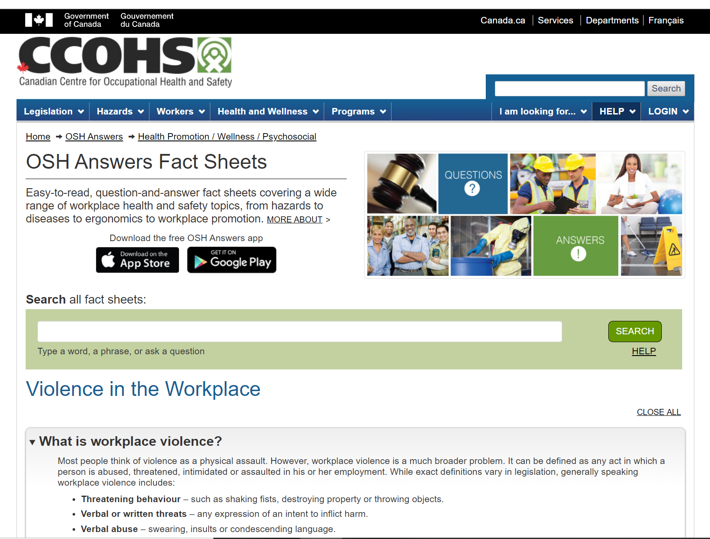

Slide 47
Areas in the Collective Agreement to Address cont’d.
Sample areas within legislation and the OHS Regulations that should also be included in Collective Agreement language if they are superior to current language:
Definitions
Critical Incident Debriefing
Employee benefits, including Extended Health Benefits
Employee training and education
Inspections and investigations
Hazard and risk assessment

Slide 48
Areas in the Collective Agreement to Address cont’d.
Employee orientations (not just new employees)
No discrimination, discipline or retaliation
Return to Work
Occupational Health and Safety
Staffing levels
Volunteers
Working alone or in isolation
The roles, rights and responsibilities of the Joint Health and Safety Committee and Worker Health and Safety Representatives – be expansive as possible

Slide 49
Areas in the Collective Agreement to Address cont’d.
Be very careful about the differences between Occupational Health and Safety (Prevention) and WorkSafeBC Claims (Compensation). The law is different for each e.g. definitions.
Employer policies and procedures are in addition to the Collective Agreement. Review these in detail.
Sample language is difficult to provide because the language will vary by sector, size of Local, location of Local e.g. one location or multiple locations, presence of other Employers and Unions, injury and near miss rates, etc.

Slide 50
Know your bargaining environment.
Do the parties have similar goals and understanding of what violence is?

Slide 51
Specific Collective Agreement Articles to Address
WorkSafeBC legislation and Regulations form the basis for rights and entitlements - but these must be expanded.
It is not enough to have language stating that the Employer agrees to comply with the current WorkSafeBC Legislation and Regulations because they may change, and they are not sufficient to protect workers.
The language of the Collective Agreement should not be inferior to existing Legislation and Regulations.
The Collective Agreement should reflect that the existing Legislation and Regulations are the minimum standard.

Slide 52
Specific Collective Agreement Articles to Address cont’d.
Key Considerations:
Consider the needs of workers in precarious employment.
Safeguard and secure all private information. Comply with all privacy legislation. See FOIPPA and PIPA.
Be very careful to avoid negotiating language that may be discriminatory or a Human Rights violation.
Coordinate all overlapping legislation, obligations, rights and entitlements.

Slide 53
Are the Employer and Union equal participants in the Joint Health and Safety Committee?

Slide 54
Problems and Barriers to Bargaining Collective Agreement Language
Common problems and barriers to negotiating Collective Agreement language that protects employees includes:
Lack of Reporting / Under-reporting. Employees frequently under-report incidents of violence. This is especially prevalent in employees in precarious employment e.g. casuals, temporary employment etc.
No “serious” injury occurring. Definition of injury.
Past practices and workplace culture.

Slide 55
Problems and Barriers to Bargaining Collective Agreement Language cont’d.
Expectations that violence is “Part of the job” e.g. First Responders, K-12, Social Services and Healthcare
Lack of information, statistics or incorrect data
Retaliation, discipline, retaliation, claims suppression, and reprisal by Employers
Unclear or poorly enforced reporting processes
No follow-up by Employers or the Joint Health and Safety Committee
Lack of training and education
Lack of clarity on what violence includes…

Slide 56
Verbal violence, Violence takes many forms – violence is violence

Slide 57
Problems and Barriers to Bargaining Collective Agreement Language cont’d.
Literacy issues
Lack of information in multiple languages
Confusion over what is confidential. Employers have frequently sought to limit the information given to the Joint Health and Safety Committee and employees by referring to confidentiality or Management Rights
Non-functioning Joint Health and Safety Committees
Confusion over forms and overlap of processes e.g. grievance vs. OHS vs. WorkSafeBC claim

Slide 58
Resources and Links
See the Word version of this document for an extensive list of resources

Slide 59
Questions?

Slide 60
These materials are for education purposes only and are without prejudice and precedent to any other proceeding. cope491 tm/jd Reps_T-McKenna_Workshops_Presentations_Violence-Bargaining-Negotiating-CA_Language-Part-2-of-2-Revised-01-30-2020

